Slide 1
Student mentoring system
UNDER THE GUIDANCE OF
Prof. Sarat Saharia
Team members
Manjit Barman (Csm21019)
Nitish Rajbongshi (csm21033)

Slide 2
Introduction
The student mentoring system is a web-based mentoring system that provides the functionality to assign the mentor and facilitates communication between the student and the mentor.
This web application is beneficial to students, teachers, and administrators.
The architecture of the system described here is specific to Tezpur University but can be implemented at other academic institutions.

Slide 3
Need of student mentoring system
Manual mentoring processing is generally time consuming and have other disadvantages.
A conventional system has huge gap in interaction among mentors and students.
Every time students are called into the cabin for any kind of discussion.
If any students have any problem, they have to first find his/her mentor meet him/ her personally to take appointment and after that they can discuss problem.
There are no records in the current system of any previous problems discussed or suggestions made by the mentor.

Slide 4
Proposed system
The proposed system allocates mentors with one click.
It is faster, convenient and manages time more effectively.
It facilitates efficient interaction between student and mentor.
Details are stored in a database where they can be easily updated and monitored.
It also serves as a forum for students to provide feedback or express concerns to their mentors.
Communication can be done remotely between the student and mentor.

Slide 5
Project description
Student mentoring application is complete management and informative system.
Overcome the difficulty of manually managing the records.
Logging in will direct the user to their respective page.
Each user have respective user dashboard.

Slide 6
Functionality
Data can be entered one at a time or through an excel file.
Assign a mentor per student with one click.
Students will receive an email as an alert.
Share data as a pdf file like mentee progress form.
View and export mentor mentee list.
Both student and mentor can view the scheduled meeting and give remarks etc.

Slide 7
How system work
Block diagram
Mentor module
Admin adds mentor details
arrange
Provides gives feedback to mentor
Meeting
Admin module
Add student
Gives remarks based on meeting and query
Admin adds student details
View meeting schedule
Student module

Slide 8
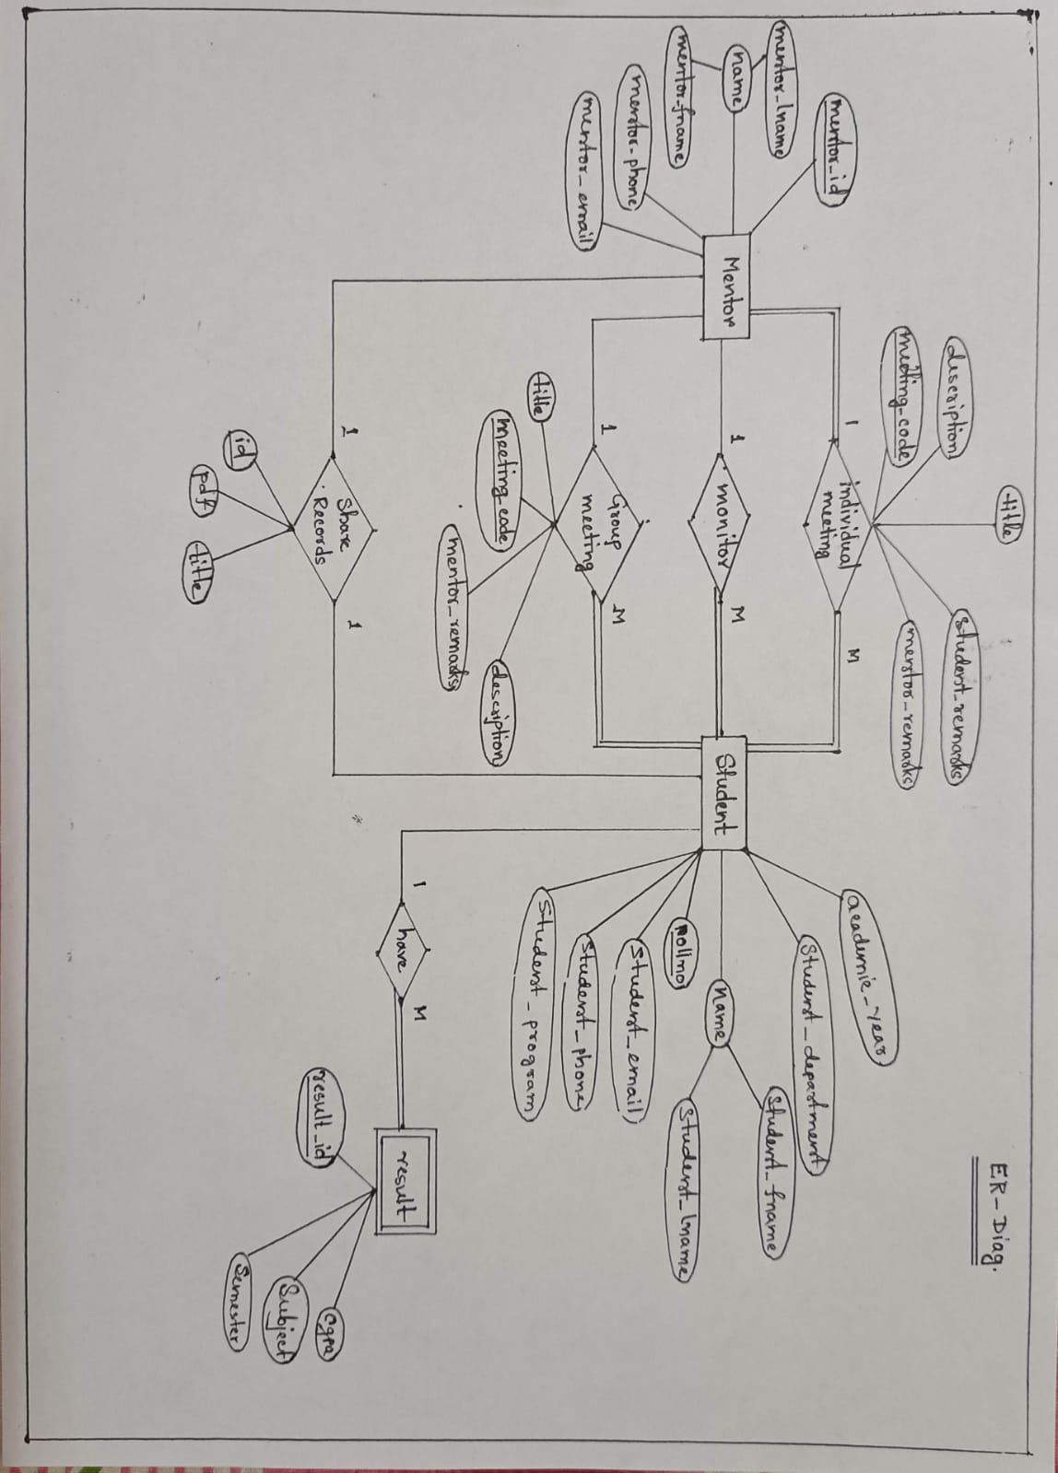
ER diagram

Slide 9
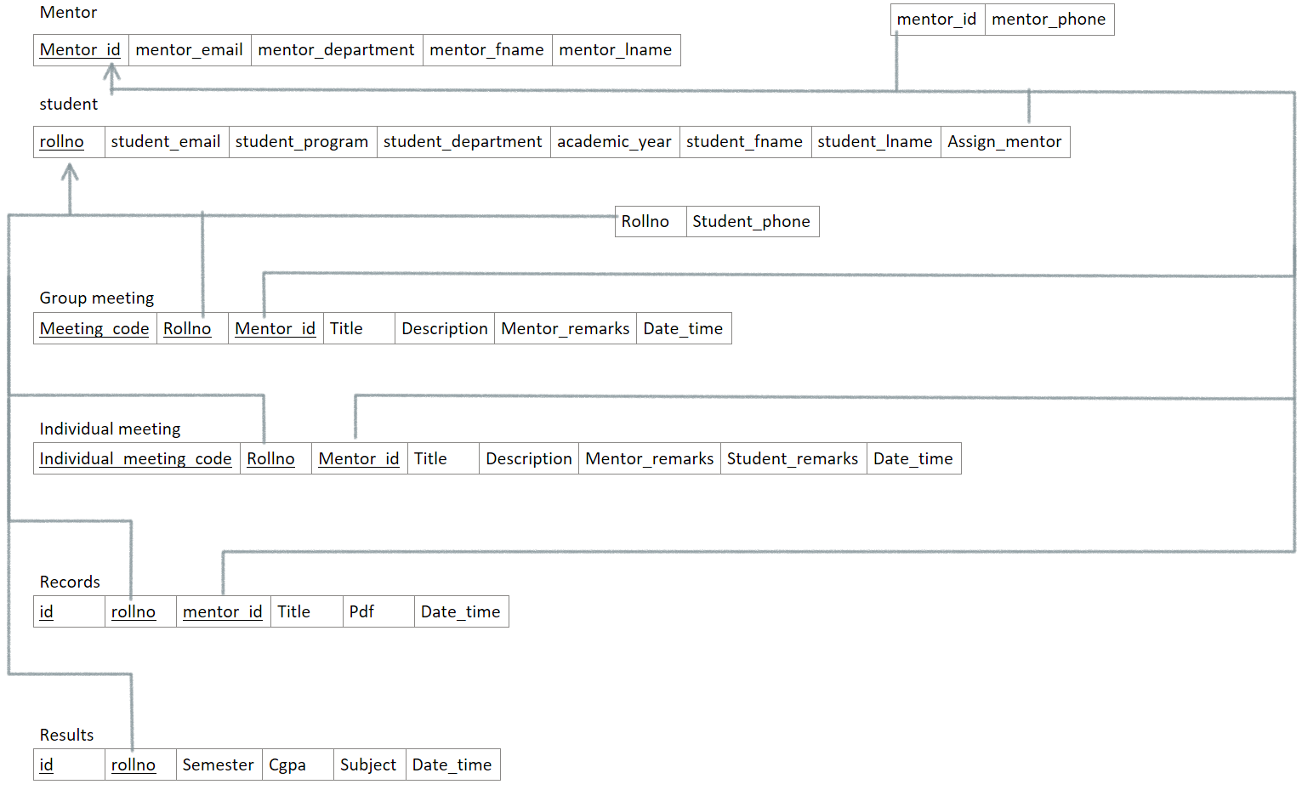
Relational Model

Slide 10
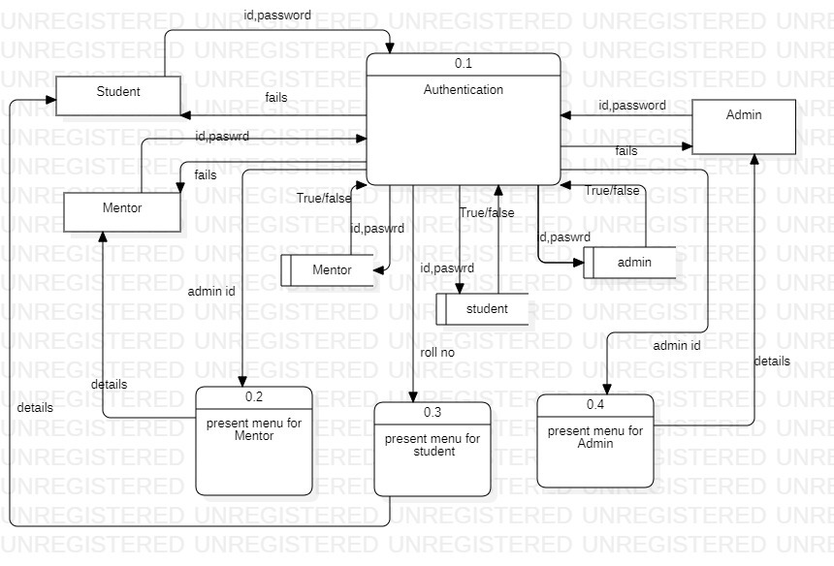
Data flow diagram

Slide 11
Conclusion and future enhancement
Add services (like view attendance, point to point message passing.)
Improve visiting experience of attendances.
Generate monthly wise performance report automatically.
Actual virtual meeting like video calling.
Conclusion:
Near to completion to what was planned and designed earlier.
Data dictionary may changed when we will modify the system in future.
We have tried our best to overcome the existing limitations.

Slide 12
Live Demo

Slide 13
Thank you

